Slide 1
BTC Trading Signal Generation:
Integrating Market Microstructure and Technical Indicators

Slide 2
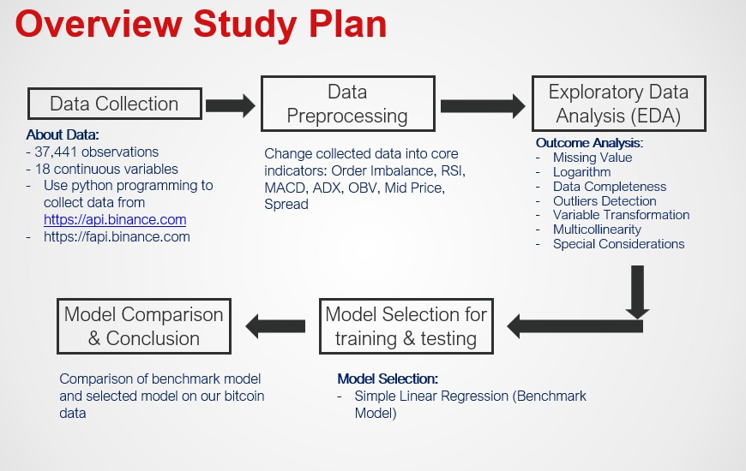
Motivation
Overview
IDA Template

Slide 3
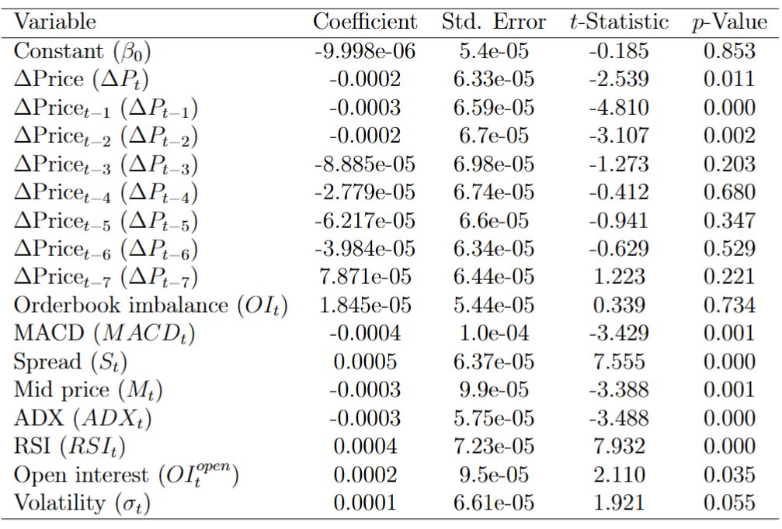
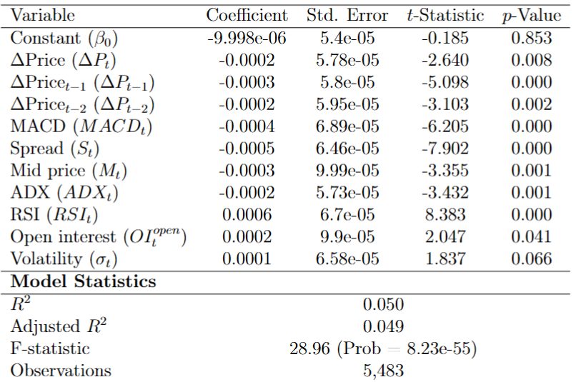
Motivation
Research Design
Benchmark model: OrdinaryLeast Squares (OLS) regression
IDA Template

Slide 4
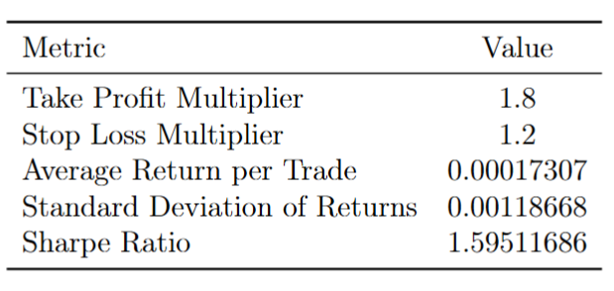
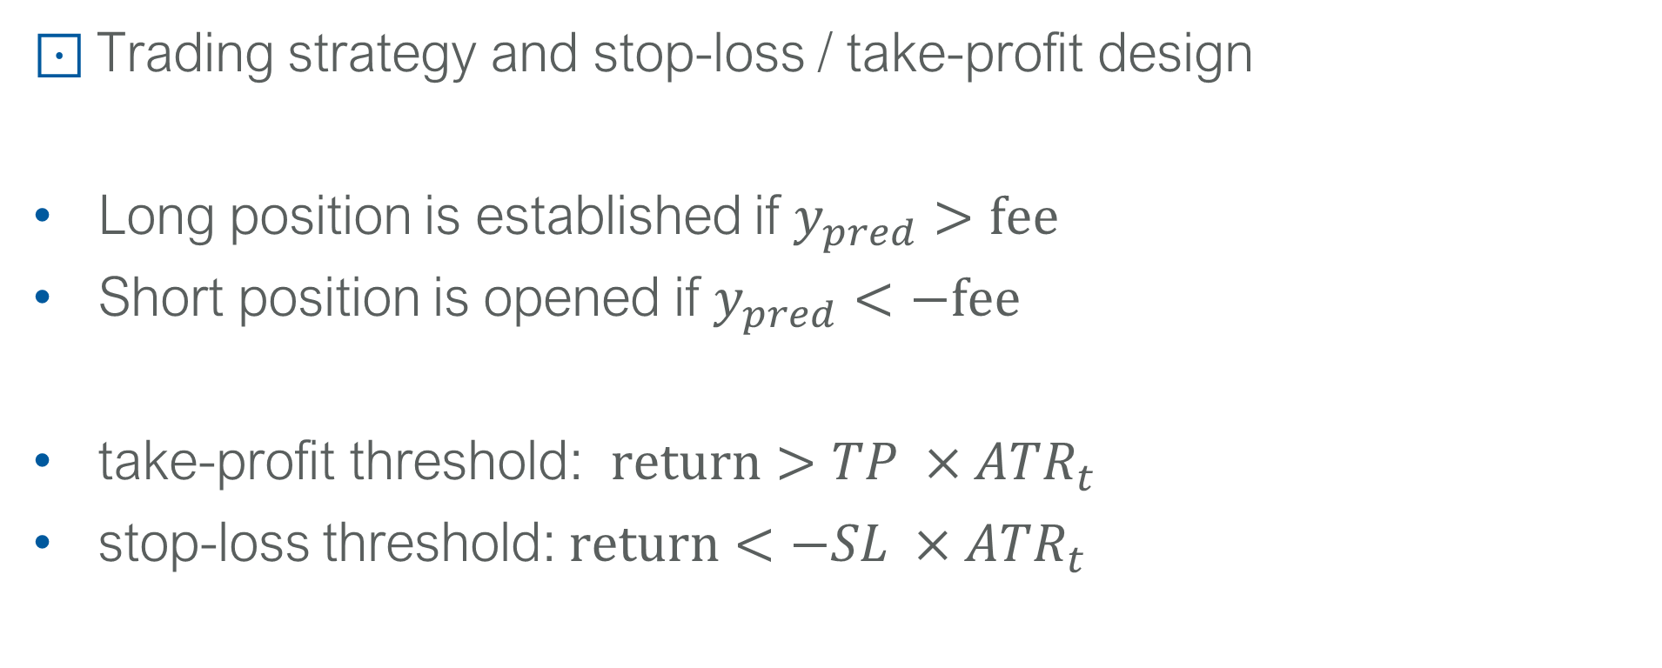
Motivation
Research Design
Trading strategy and stop-loss / take-profit design
Long position is established if $y_{pred}>\text{fee}$
Short position is opened if $y_{pred}<−\text{fee}$
take-profit threshold: $return>TP ×ATR_{t}$
stop-loss threshold: $return<−SL ×ATR_{t}$
IDA Template

Slide 5
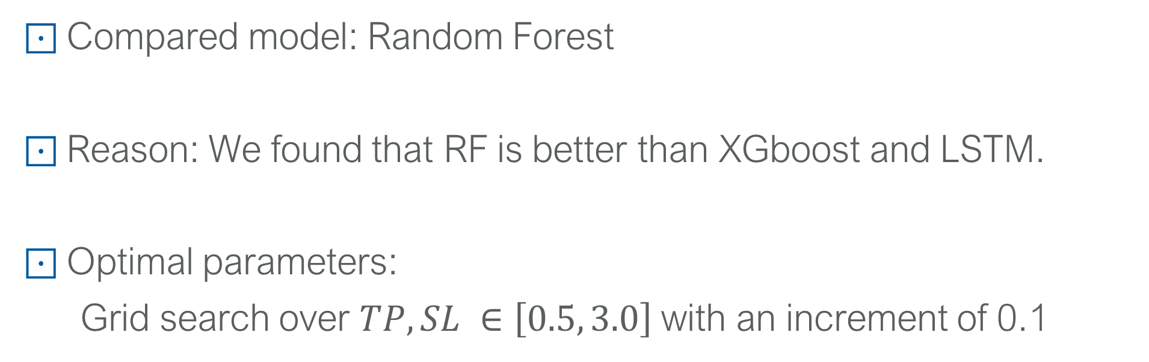
Motivation
Research Design
Compared model: Random Forest
Reason: We found that RF is better than XGboost and LSTM.
Optimal parameters:
Grid search over $TP, SL ∈\left[0.5, 3.0\right]$with an increment of 0.1
IDA Template

